Slide 1

GROUP 5
OBIAKU VALENTINE CHIKE
JANVI
KARMJEET KAUR
RAMANDEEP SINGH
HEALTHCARE DATASET

Slide 2
ROLE SPECIFICATION
JANVI – Data Acquisition, Cleaning Data
RAMANDEEP SINGH – Conversion of Data , Loading Data into NoSQL DATABASE , Querying Data
KARMJEET KAUR – Data visualization and predictive analysis
OBIAKU VALENTINE CHIKE- Queries in pyspark and drawing conclusions.

Slide 3

ANALYSING HEALTHCARE KAGGLE DATASET

Slide 4
Hypothesis: The count of cancer patients has increased over the years as well as cost of treating this medical condition. Goal : To analyze various aspects of healthcare to induce the cost paid by patients on different ailments.

Slide 5
DATASET OVERVIEW
DATASET IS FROM KAGGLE
HEALTHCARE DATASET 2023
DATASET IS IN CSV FILE
DATASET CONTAINS
GENDER
BLOOD TYPE
BILLING AMOUNT
ADMISSION
MEDICATION
TEST RESULTS etc.
DATA GATHERING
CLEAN DATA
CONVERT DATA INTO JSON FILE
IMPORT DATA IN MONGODB
QUERY & VISUALIZE DATA

Slide 6
PROJECT
TOOLS
PYTHON
CLOUD MONGODB
PYMONGO
JUPYTER NOTEBOOK
VISUAL STUDIO CODE
TABLEAU
CSV TO JSON CONVERTER
APACHE SPARK
MATPLOTLIB

Slide 7
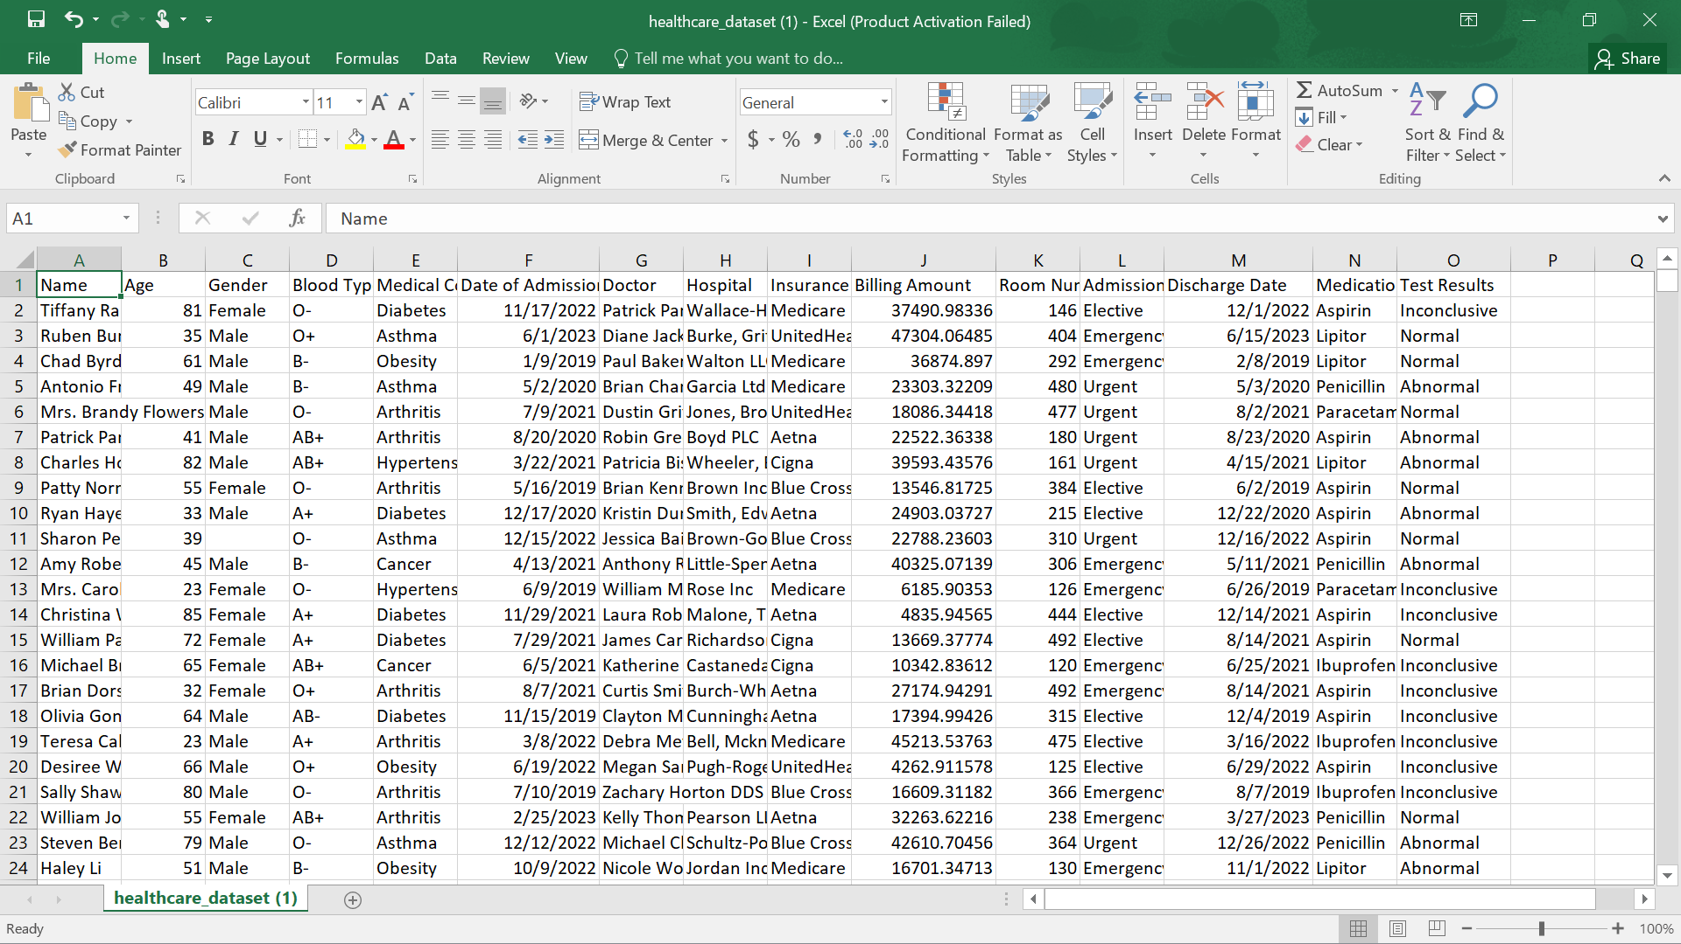
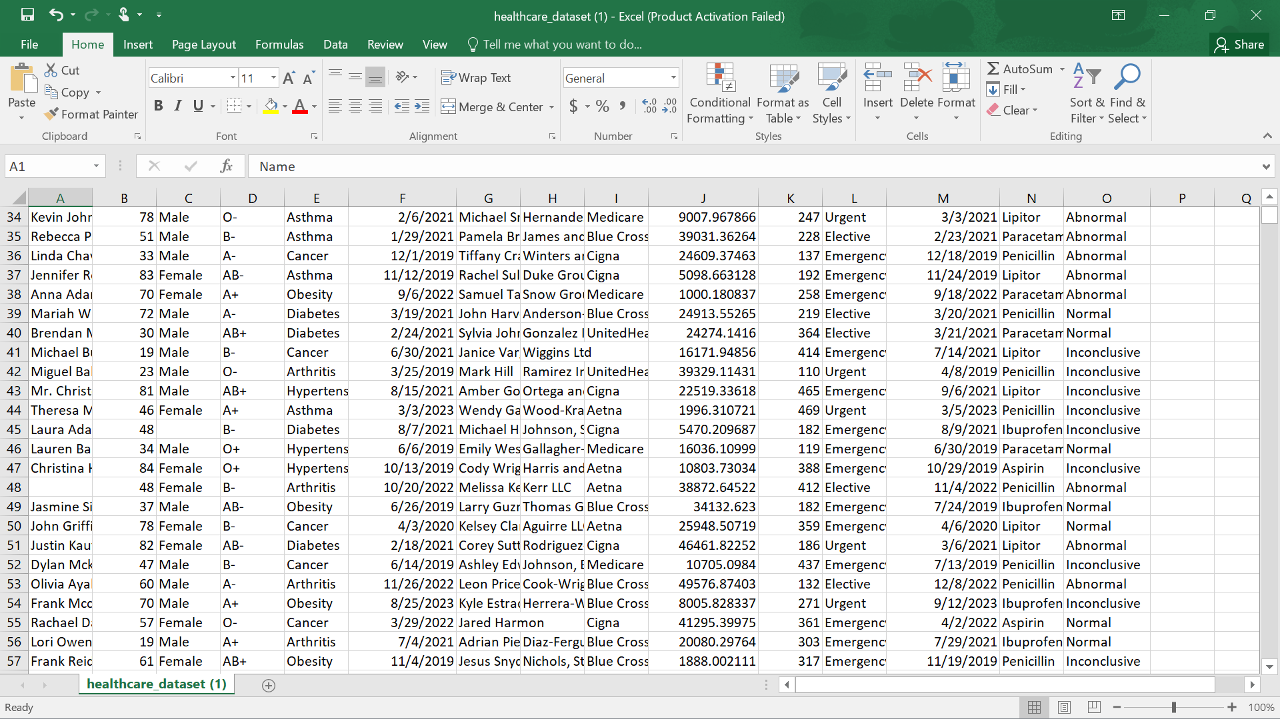
RAW DATASET FROM KAGGLE
https://www.kaggle.com/datasets/prasad22/healthcare-dataset
UNCLEANED
MISSING DATA IN ROWS AND COLUMNS

Slide 8
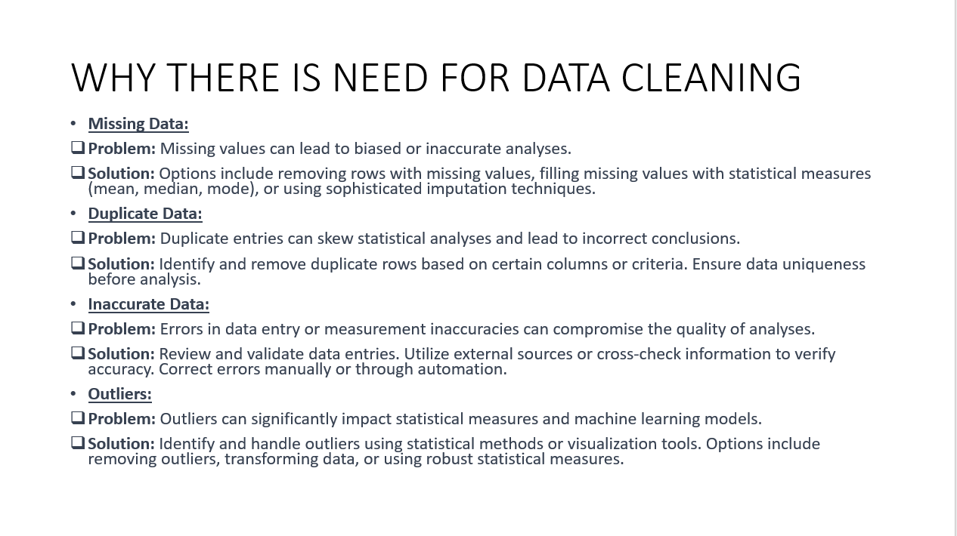
WHY THERE IS NEED FOR DATA CLEANING
WHY THERE IS NEED FOR DATA CLEANING
Missing Data:
Problem: Missing values can lead to biased or inaccurate analyses.
Solution: Options include removing rows with missing values, filling missing values with statistical measures (mean, median, mode), or using sophisticated imputation techniques.
Duplicate Data:
Problem: Duplicate entries can skew statistical analyses and lead to incorrect conclusions.
Solution: Identify and remove duplicate rows based on certain columns or criteria. Ensure data uniqueness before analysis.
Inaccurate Data:
Problem: Errors in data entry or measurement inaccuracies can compromise the quality of analyses.
Solution: Review and validate data entries. Utilize external sources or cross-check information to verify accuracy. Correct errors manually or through automation.
Outliers:
Problem: Outliers can significantly impact statistical measures and machine learning models.
Solution: Identify and handle outliers using statistical methods or visualization tools. Options include removing outliers, transforming data, or using robust statistical measures.

Slide 9
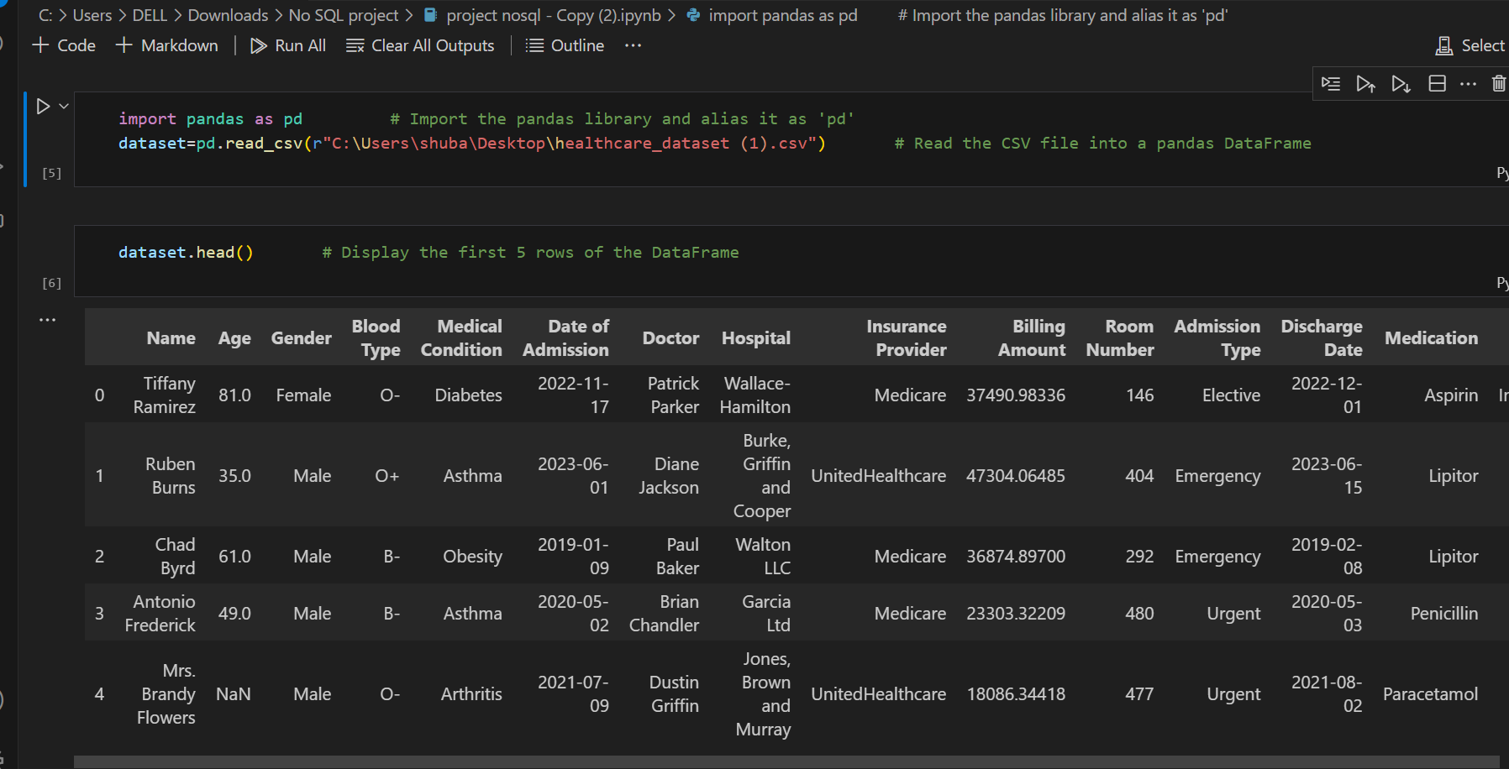
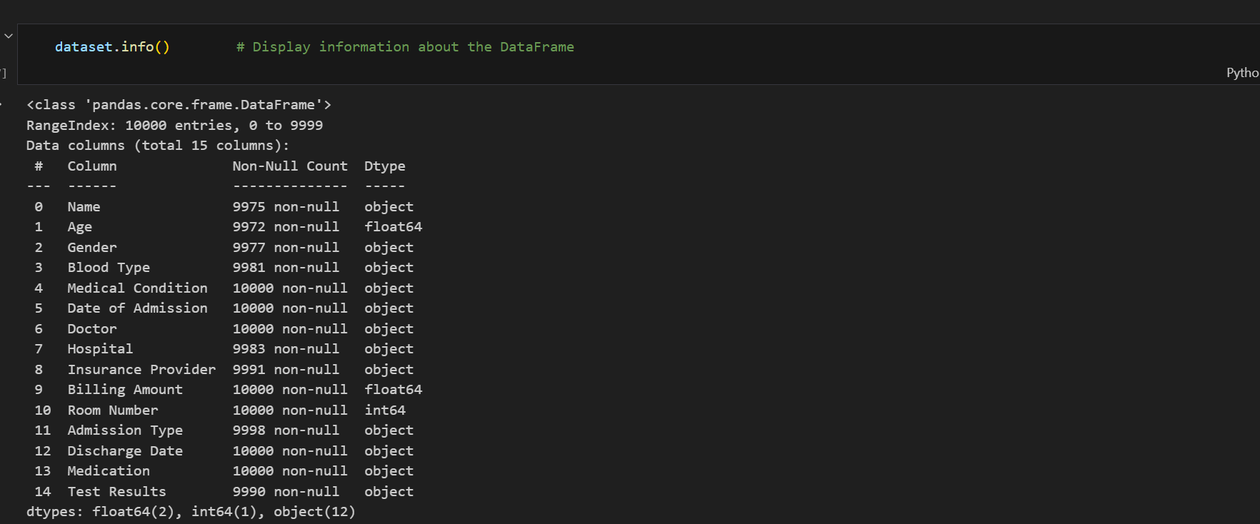
DATA CLEANING
USING VISUAL STUDIO CODE
IMPORT THE PANDAS LIBRARY AS “pd”
LOAD THE HEALTHCARE DATASET INTO THE PANDAS DATAFRAME
DISPLAY THE FIRST 5 ROWS
DISPLAY INFORMATION ABOUT THE DATA

Slide 10
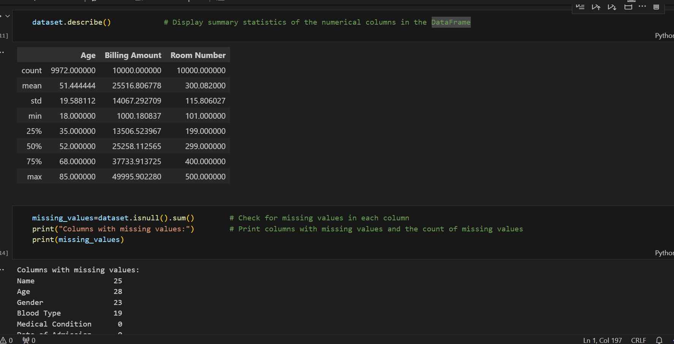
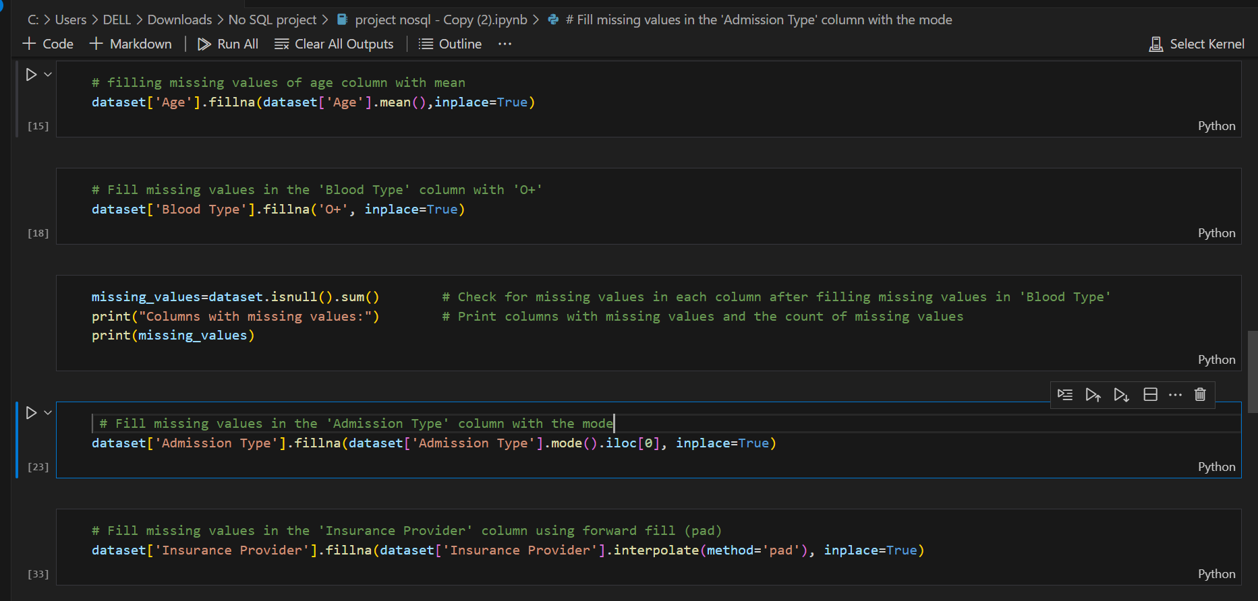
DISPLAY THE SUMMARY OF THE DATA
CHECK FOR MISSING VALUES IN EACH COLUMNS
FILL MISSING VALUES OF “AGE” COLUMN WITH MEAN VALUES
FILL MISSING VALUES OF “BLOOD TYPE” COLUMN WITH “O+”
FILL MISSING VALUES OF “ADMISSION TYPE” COLUMN WITH MODE VALUES
FILL MISSING VALUES OF “INSURANCE PROVIDER” COLUMN USING FORWARD FILL (PAD)

Slide 11
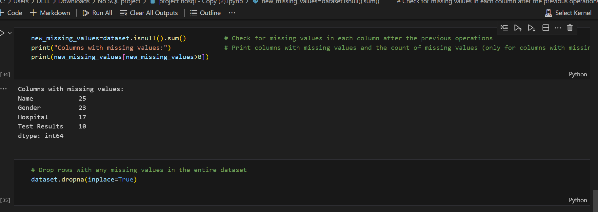
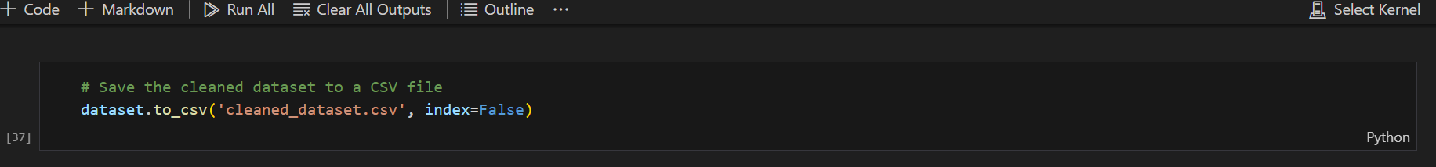
CHECK MISSING VALUES IN EACH COLUMN AFTER THE PREVIOUS OPERATIONS
DROP ROWS WITH ANY MISSING VALUES IN THE ENTIRE DATASET
FINALLY, SAVE THE CLEANED DATASET TO A CSV FILE

Slide 12
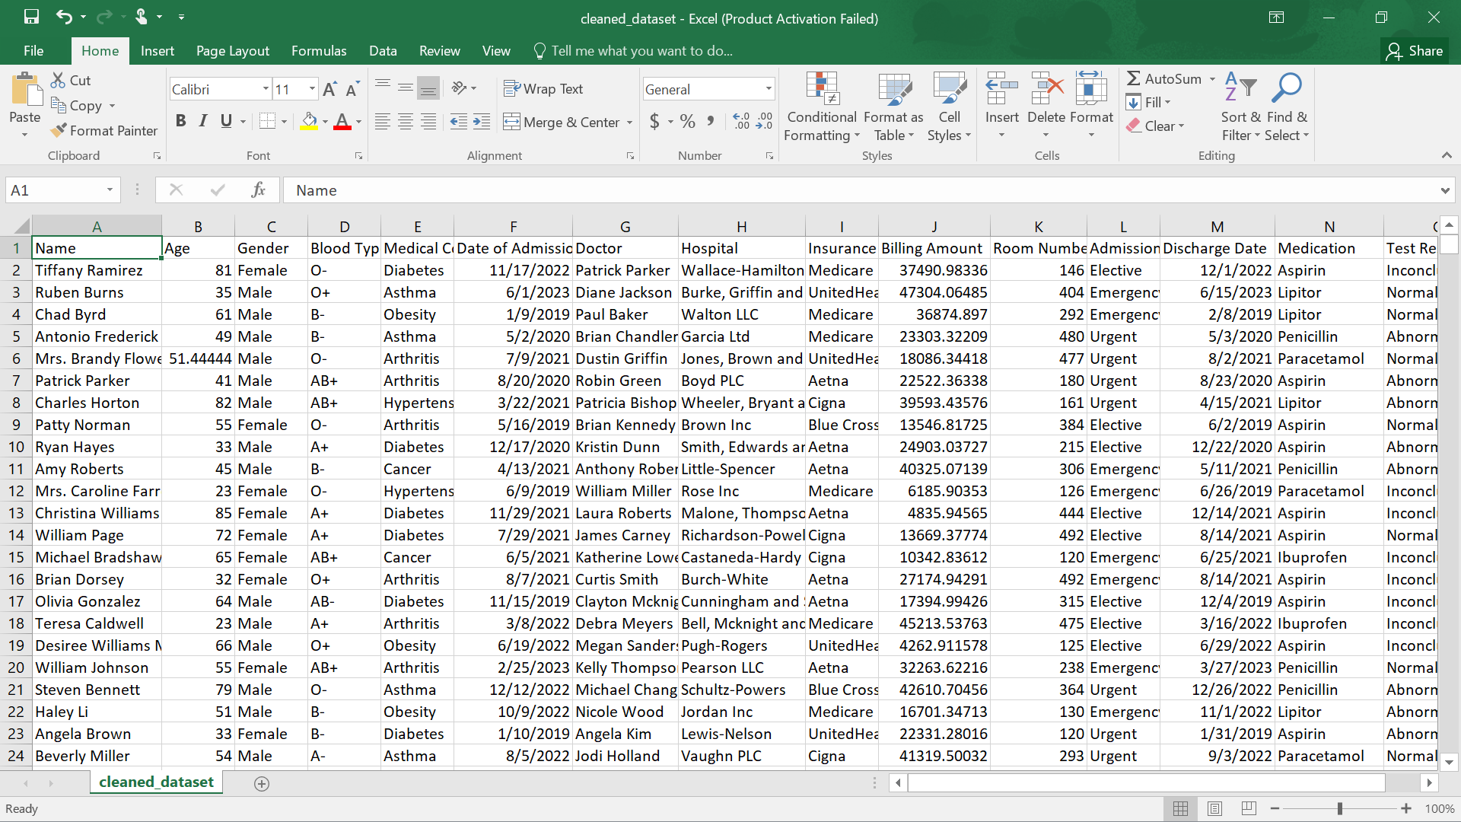
CLEANED DATASET FROM KAGGLE
CLEANED
NO MISSING ROWS
NO MISSING COLUMNS etc

Slide 13
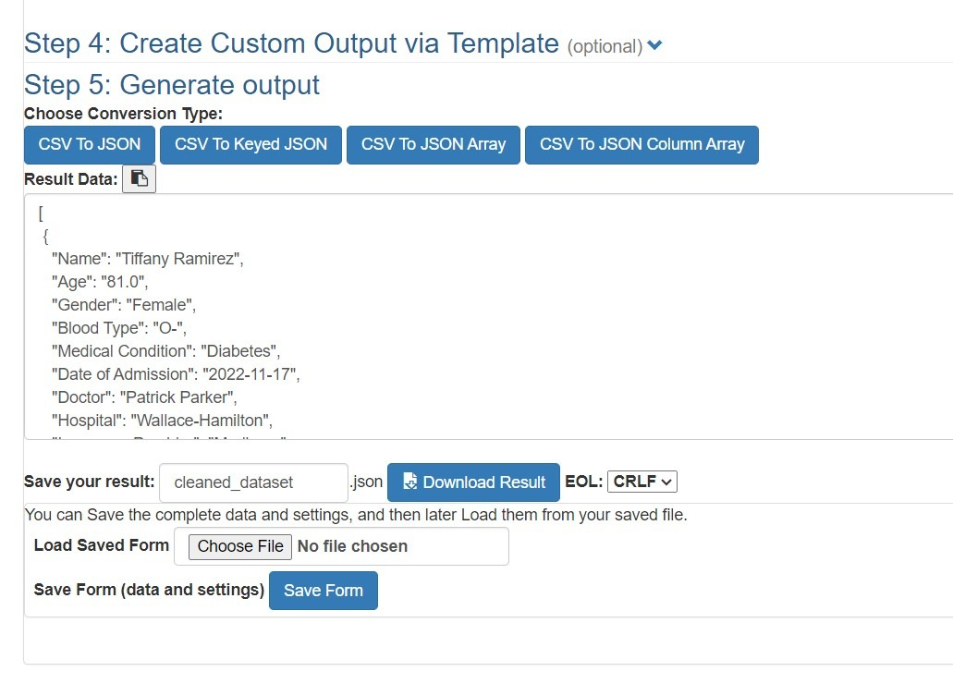
SOFTWARE TO TRANSFORM CSV FILE TO JSON FILE

Slide 14
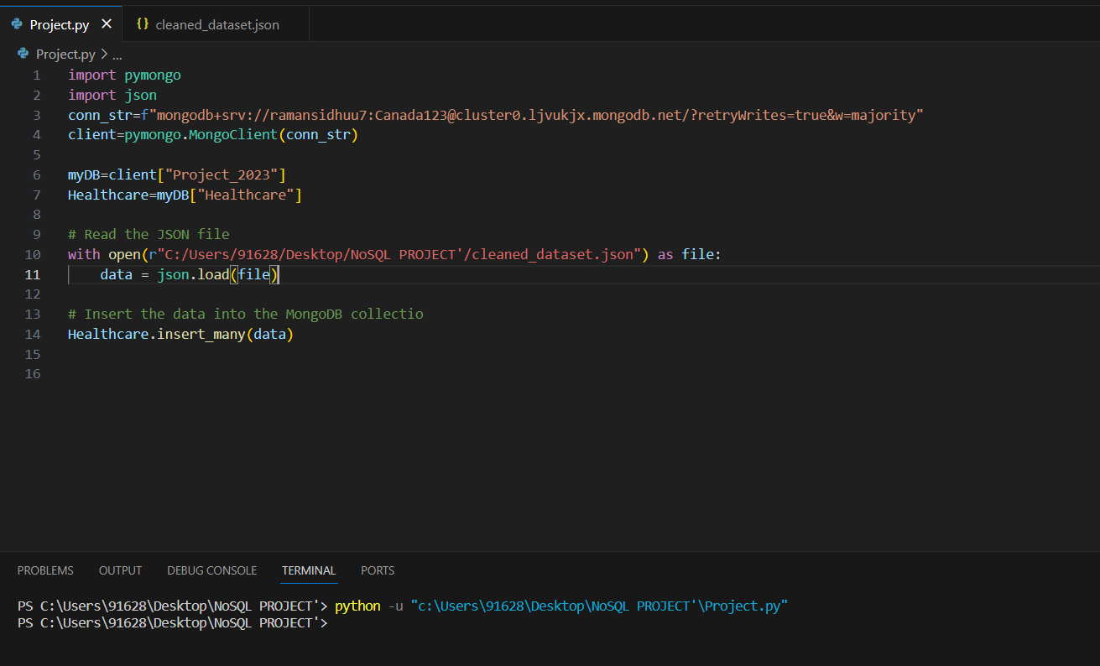
IMPORT DATASET FROM JSON FILE INTO MONGODB
USING VISUAL STUDIO CODE
IMPORT THE PYMONGO LIBRARY
IMPORT THE JSON MODULE
CONNECT TO THE MONGODB CLOUD SERVER
CREATE DATABASE IN MONGODB “PROJECT 2023”
CREATE COLLECTION “HEALTHCARE”
INSERT THE DATASET IN JSON FILE IN THE MONGODB COLLECTION “HEALTCARE”

Slide 15
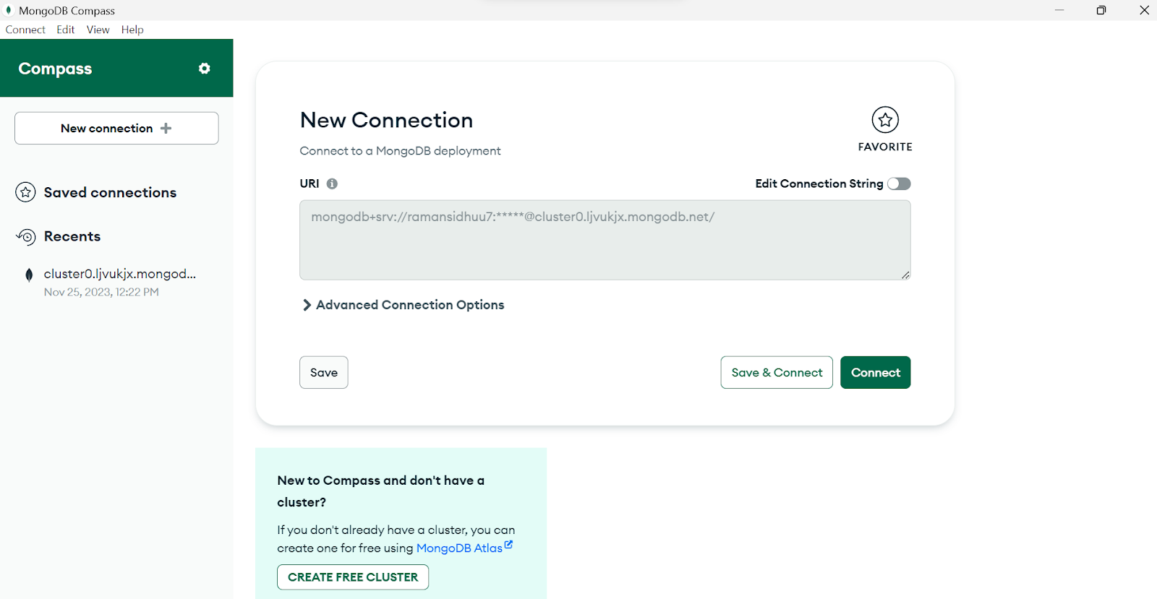
MONGODB CONNECTION USING MONGODB COMPASS
MongoDB Compass is the official graphical user interface (GUI) for MongoDB, a popular NoSQL database. It is designed to provide a visual representation and interaction with MongoDB databases, making it easier for developers, database administrators, and other users to work with MongoDB.

Slide 16
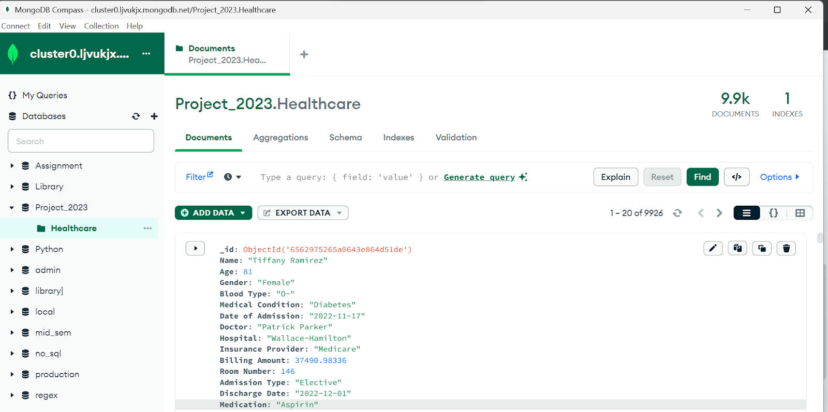
HEALTHCARE DATASET IMPORTED INTO MONGODB COMPASS

Slide 17
WHY MONGO DB ?
WHY MONGO DB ?
As Mongo db is an open source software which is used to query and store NoSQL data in flexible environment. Thus Jason files can be easily operated on closed services with help of cloud Mongo db . We have queried the NoSQL data in pymongo to derive feasible insights from the data.

Slide 18
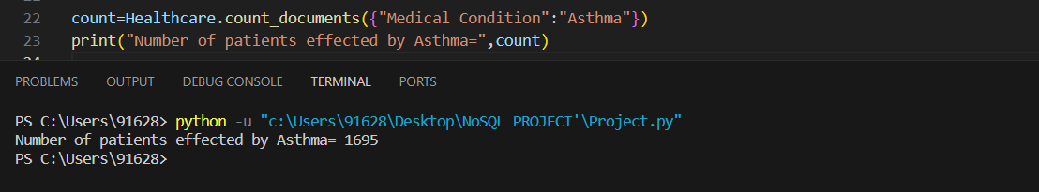
HOW MANY PATIENTS ARE AFFECTED BY ASTHMA
MONGODB QUERIES
WHAT IS THE AVERAGE BILLING AMOUNT SPENT BY CANCER PATIENTS

Slide 19
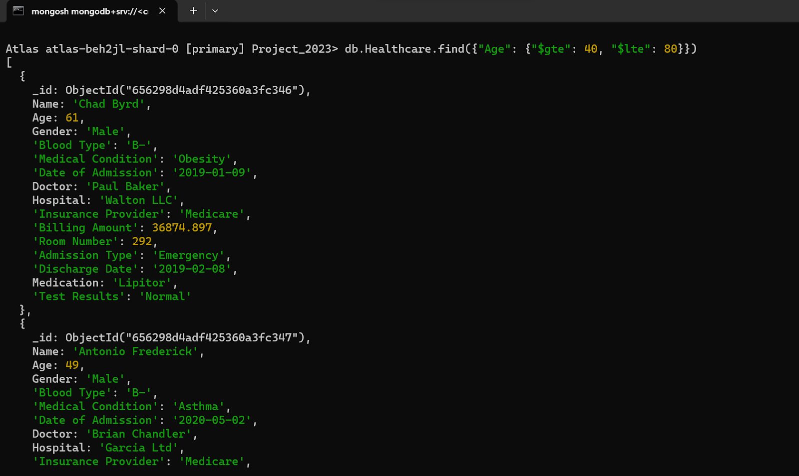
RETRIEVE PATIENTS WHO’S AGE LIES BETWEEN 40 -80 AND FIND THE COUNT OF THOSE PATIENTS.

Slide 20
WHICH BLOOD GROUP HAS MOST MEDICAL CONDITION
HOW MANY PATIENTS HAVE TEST RESULTS AS NORMAL

Slide 21
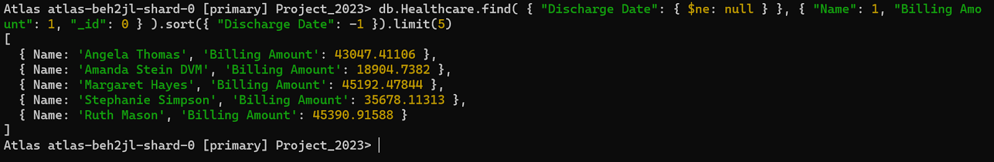
WHAT IS THE NUMBER OF FEMALES ADMITTED FOR EMERGENCY
Retrieve the medication prescribed to the highest number of patients also retrieve the number of patients.
Give the name of recent 5 patients which are discharged and mention there billing amount?

Slide 22
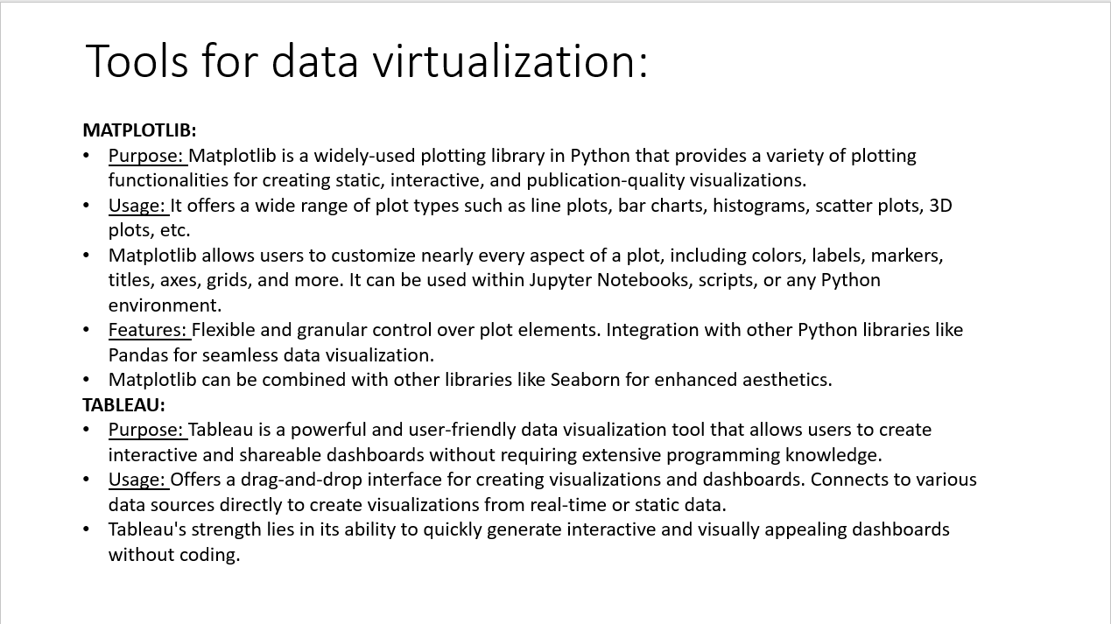
TOOLS FOR DATA VISUALIZATION :

Slide 23
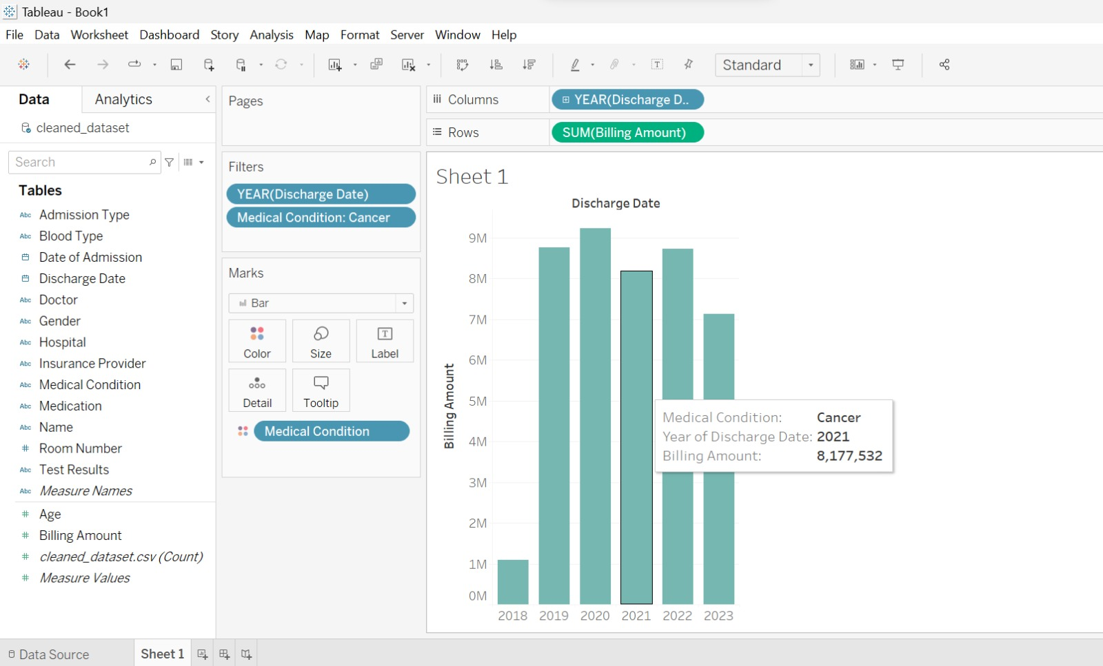
DATA VISUALIZATION USING TABLEAU
COST OF MEDICATION ON TREATMENT OF CANCER FOR ALL YEAR

Slide 24
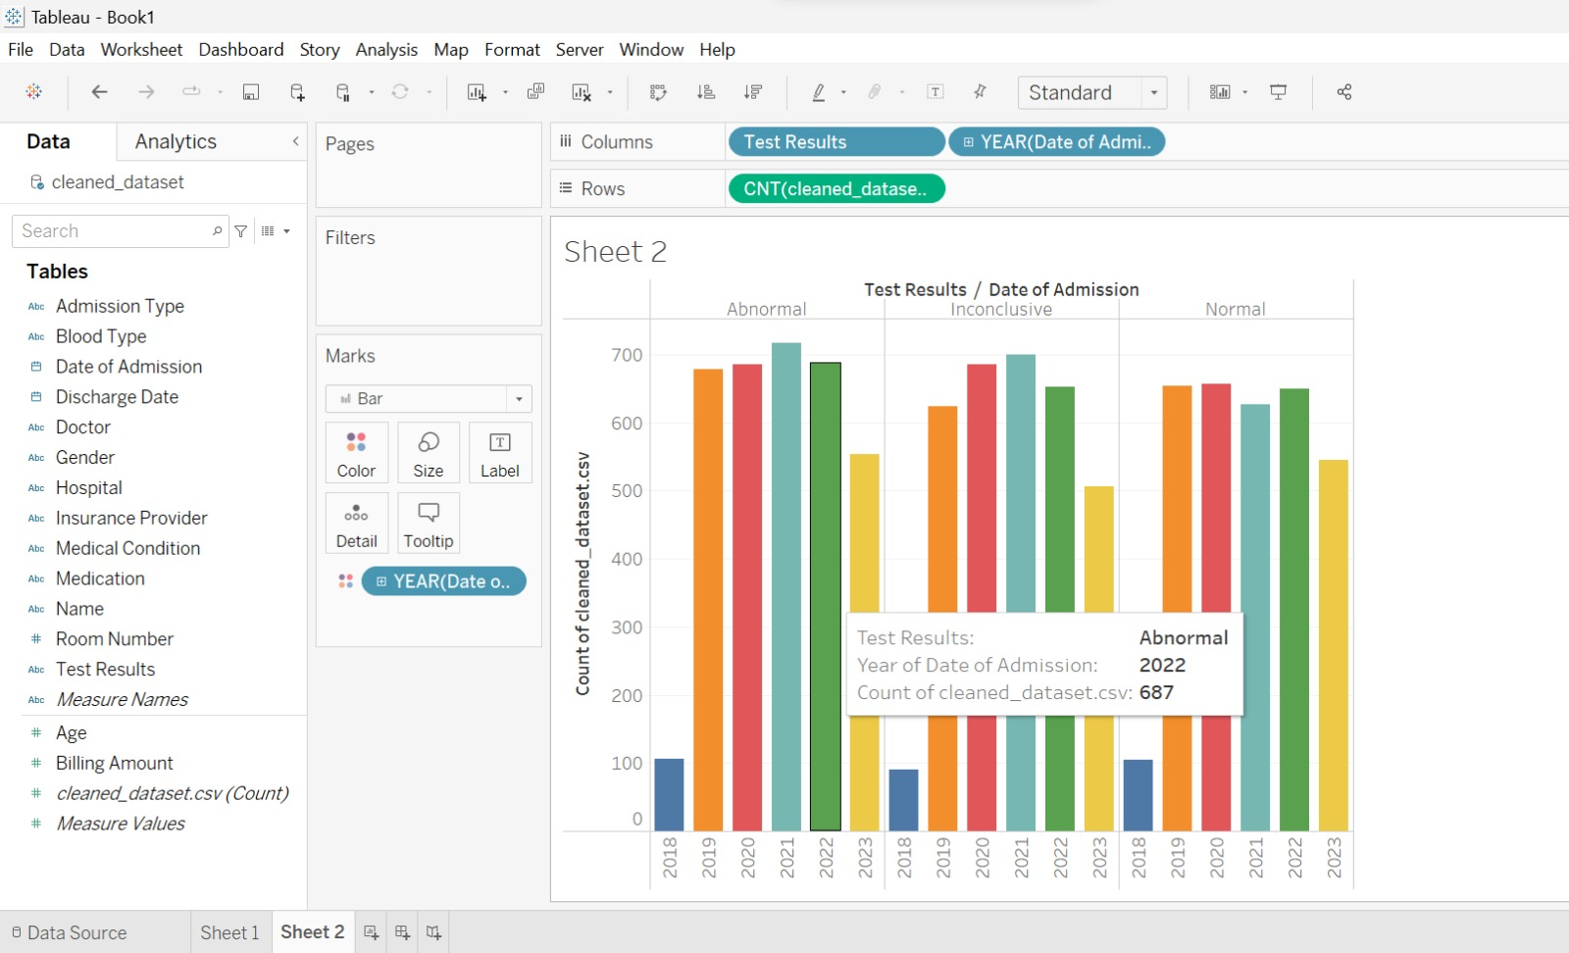
COUNT OF THE PATIENTS FOR THE TEST RESULT FOR DIFFERENT YEARS

Slide 25
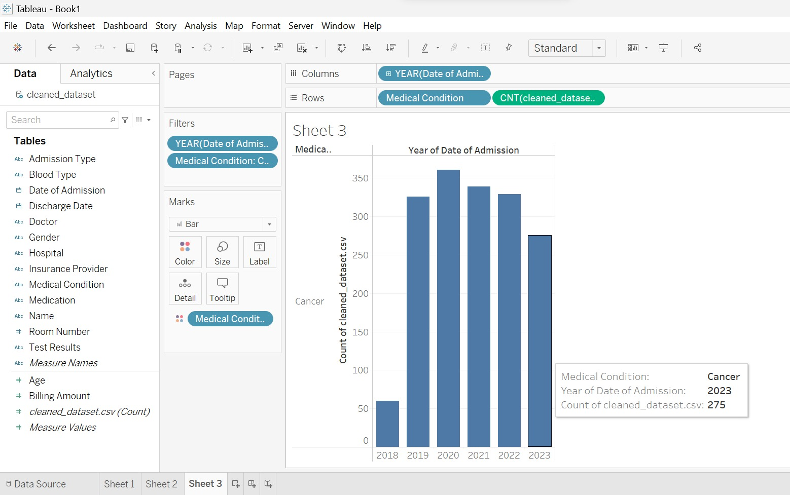
COUNT OF PATIENTS OF CANCER FOR ALL YEARS

Slide 26
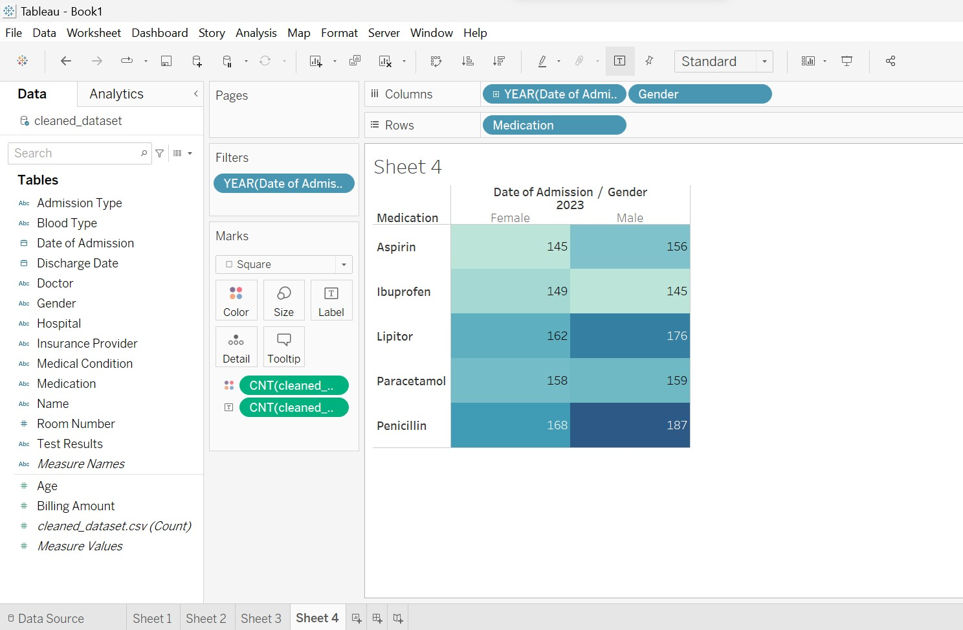
COUNT OF MEDICINES CONSUMED BY MALES AND FEMALES IN DIFFERENT YEAR

Slide 27
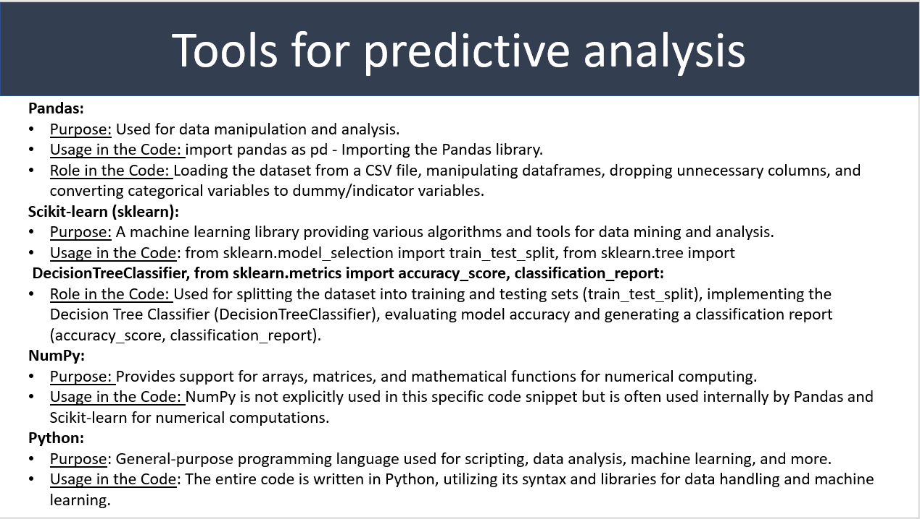

Slide 28
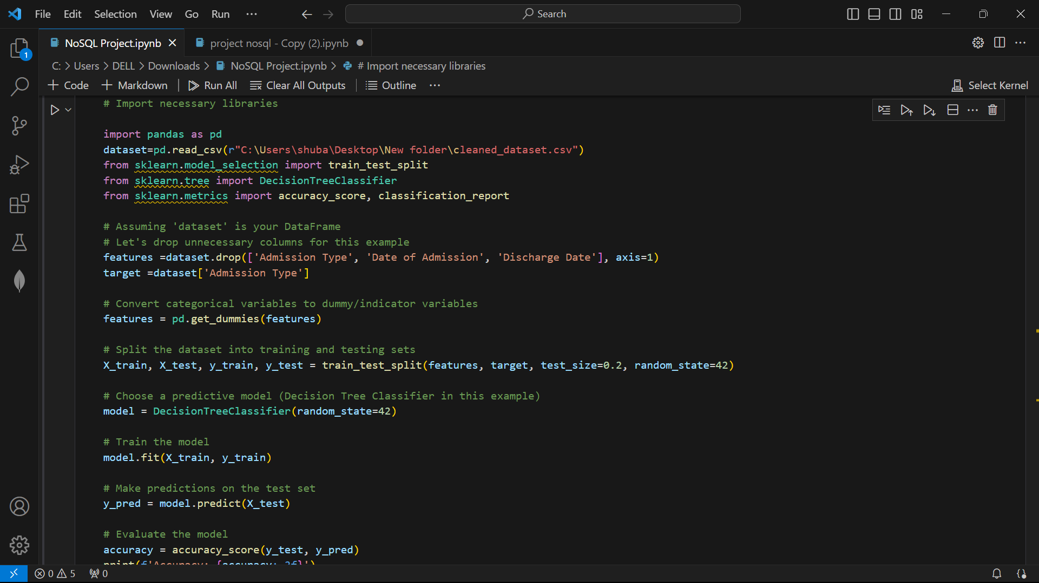
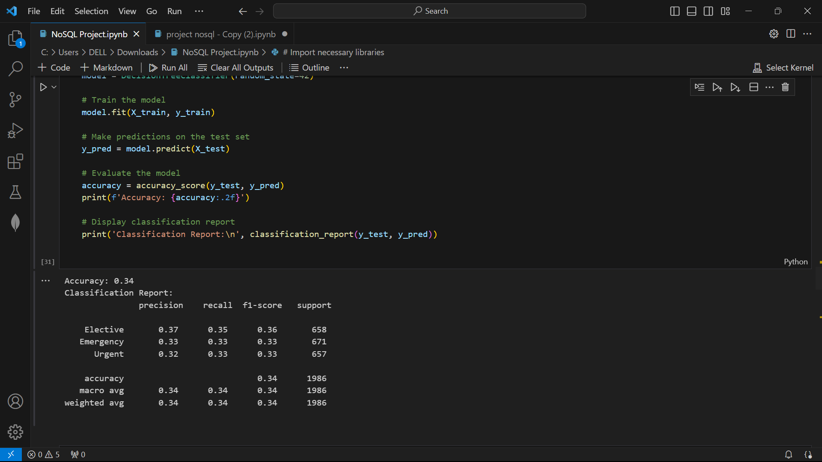
PREDICTIVE ANALYSIS OF DATASET
IMPORT NECESSARY LIBRARIES, PANDAS, TRAIN_TEST_SPLIT, DECISIONTREE CLASSIFIER, ACCURACY SCORE, CLASSIFICATION REPORT
DROP UNNECESSARY COLUMNS
CONVERT CATERGORICAL VARIABLES TO DUMY INDICATORS
SPLIT DATASET INTO TRAINING AND TESTING SETS
CHOSE A PREDICTIVE MODEL (DECISION TREE)
TRAIN THE MODEL
MAKE PREDICTION ON THE TEST SET
EVALUATE THE MODEL
DISPLAY CLASSIFICATION REPORT

Slide 29
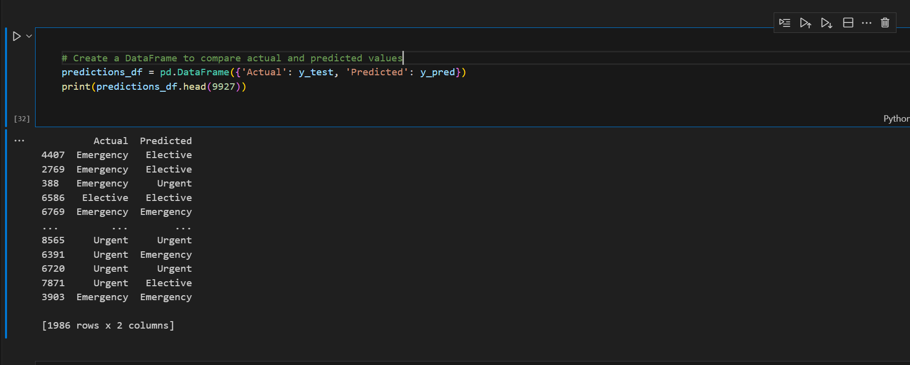
DATA FRAME CREATED TO COMPARE ACTUAL AND PREDICTED VALUES

Slide 30
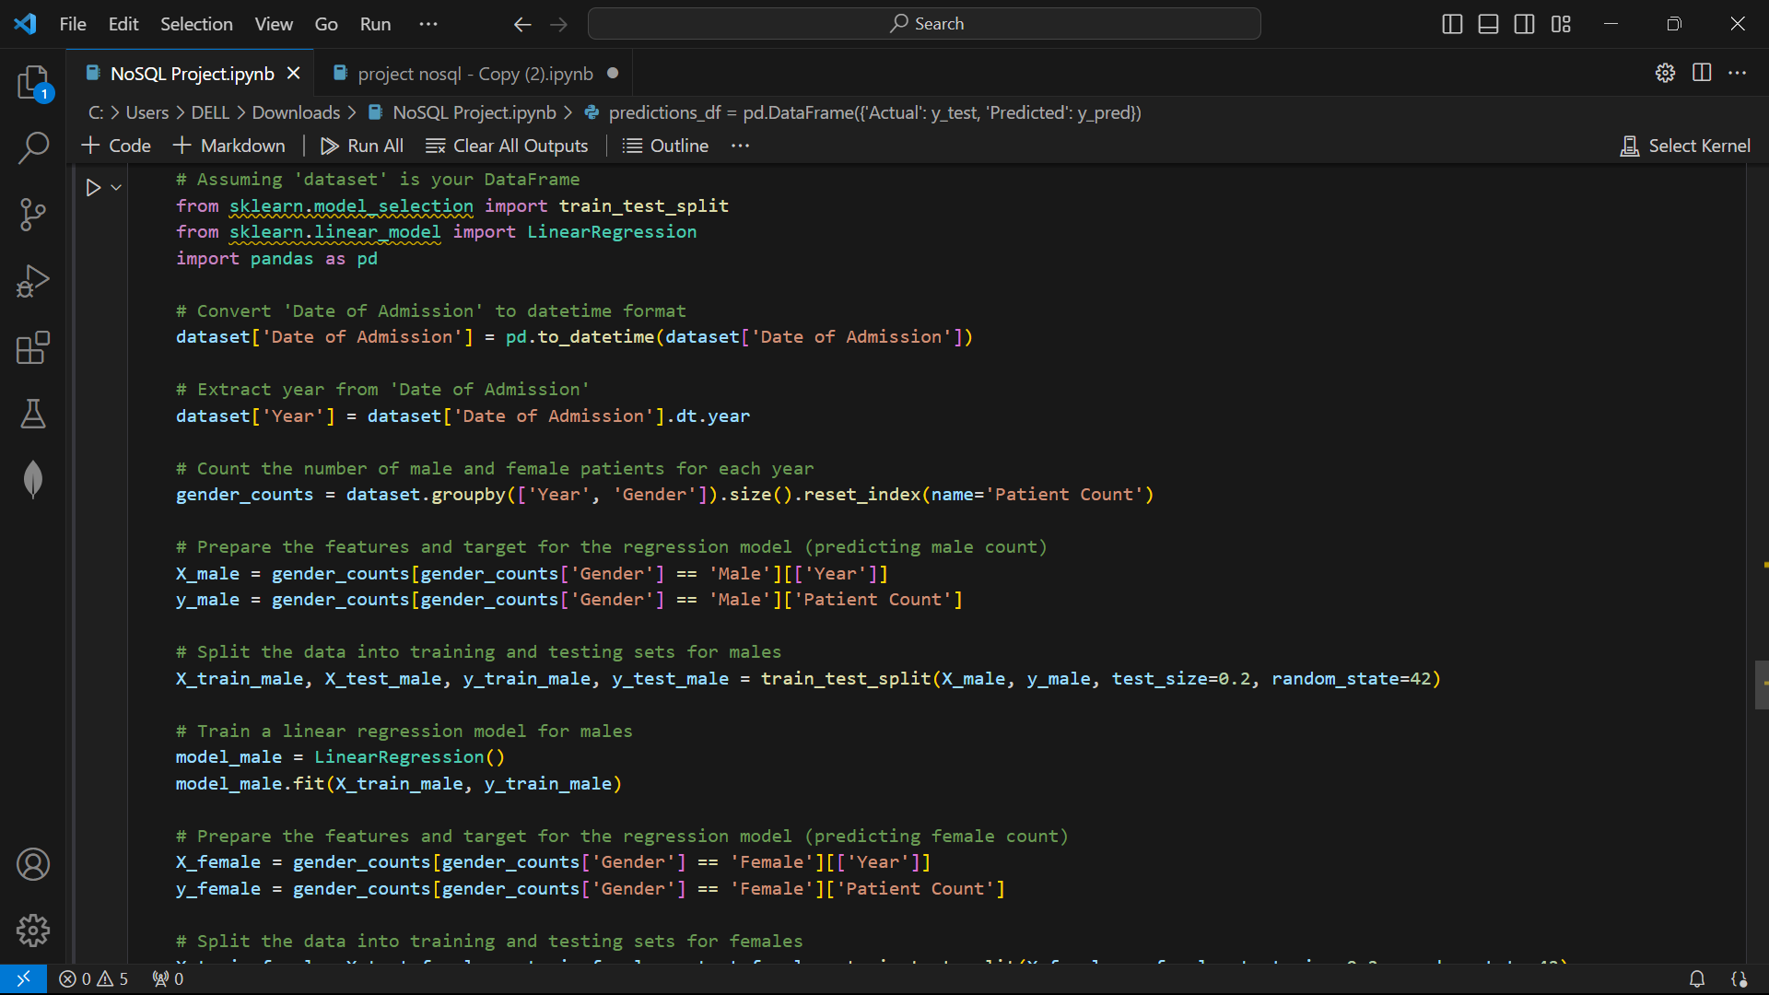
CONVERT “DATE OF ADMISSION” TO DATETIME FORMAT
EXTRACT YEAR FROM “DATE OF ADMISSION”
COUNT THE NUMBER OF MALE AND FEMALE PATIENTS FOR EACH YEAR
PREPARE THE FEATURES AND TARGET FOR THE REGRESSION MODEL (PREDICTING MALE COUNT)
SPLIT THE DATA INTO TRAINING AND TESTING SETS FOR MALES
TRAIN THE LINEAR REGRESSION FOR MALES
PREPARE THE FEATURES AND TARGET THE REGRESSIO MODEL (PREDICTING FEMALE COUNT)
SPLIT THE DATA INTO TRAINING AND TESTING SETS FOR FEMALES

Slide 31
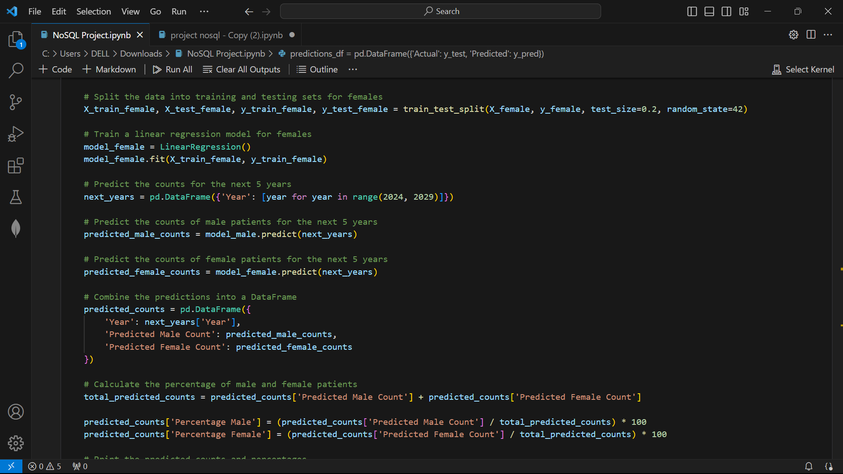
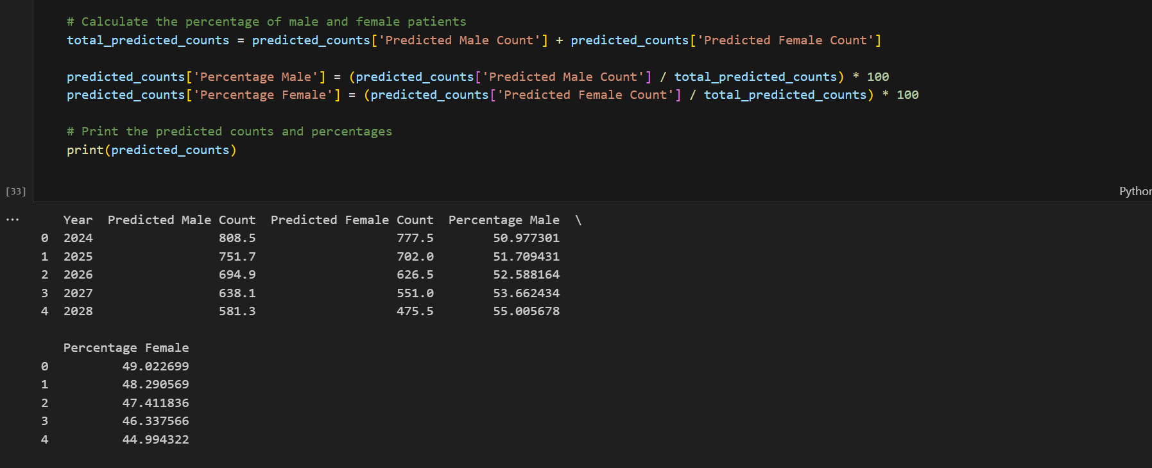
TRAIN A LINEAR REGRESSION FOR FEMALES
PREDICT THE COUNTS FOR THE NEXT 5 YEARS
PREDICT THE COUNTS OF MALE PATIENTS FOR THE NEXT 5 YEARS
PREDICT THE COUNTS OF FEMALE PATIENTS FOR THE NEXT 5 YEARS
COMBINE THE PREDICTIONS INTO A DATAFRAME
CALCULATE THE PERCENTAGE OF MALE AND FEMALES PATIENTS
PREDICTING DATA FOR NEXT 5 YEARS

Slide 32
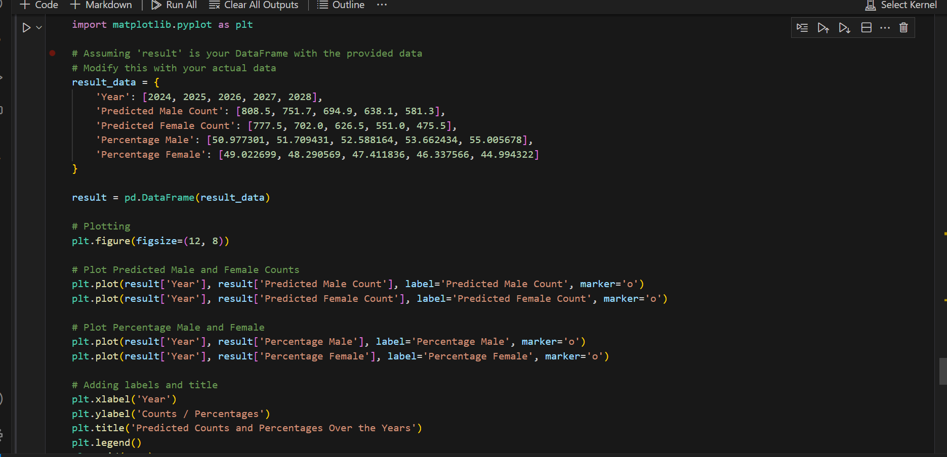
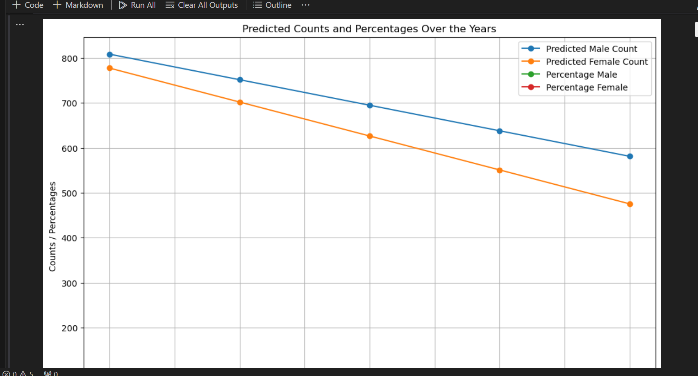
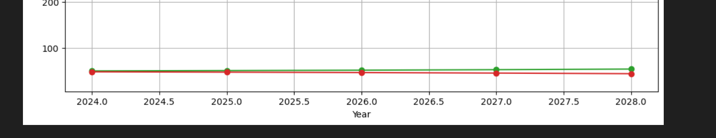
DATA VISUALIZATION FOR PREDICTIVE ANALYSIS FOR HEALTHCARE KAGGLE DATASET USING MATPLOTLIB

Slide 33
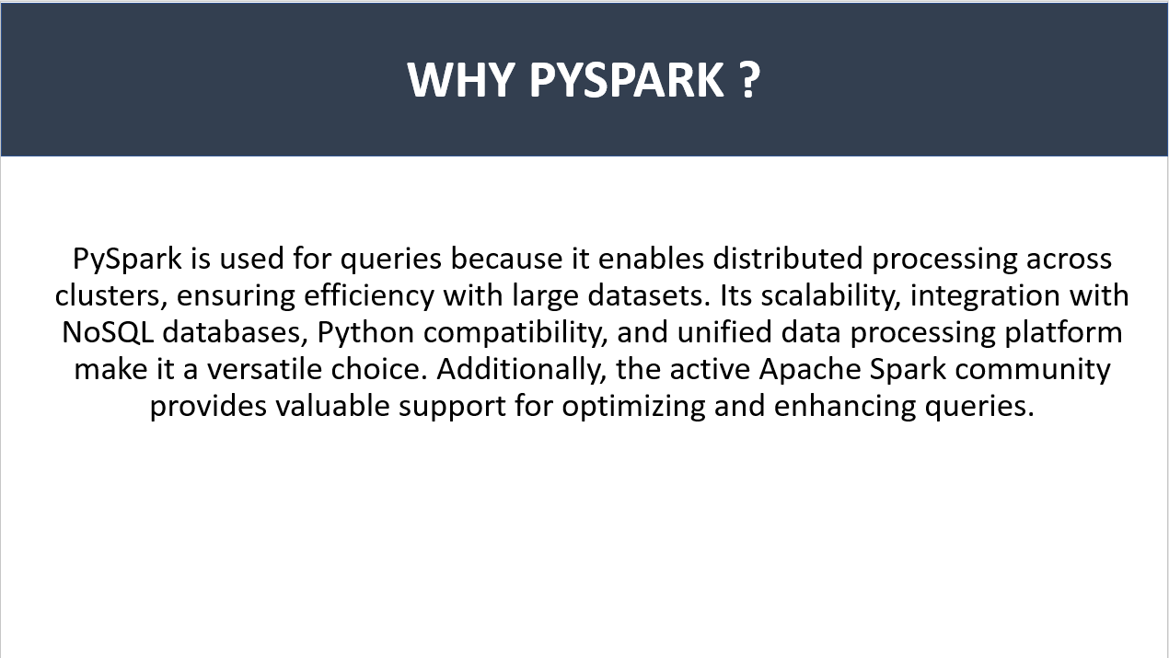

Slide 34
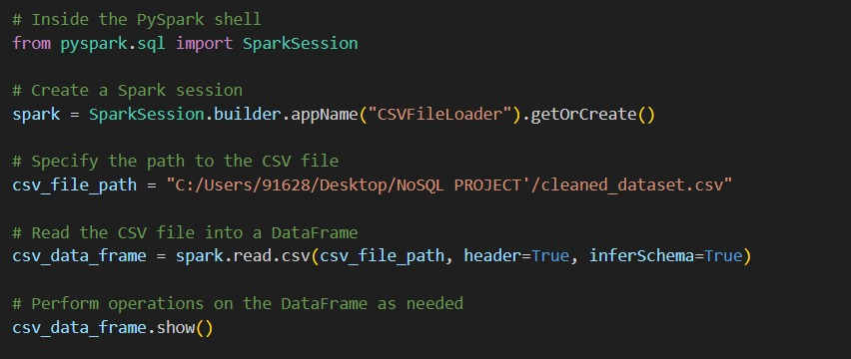
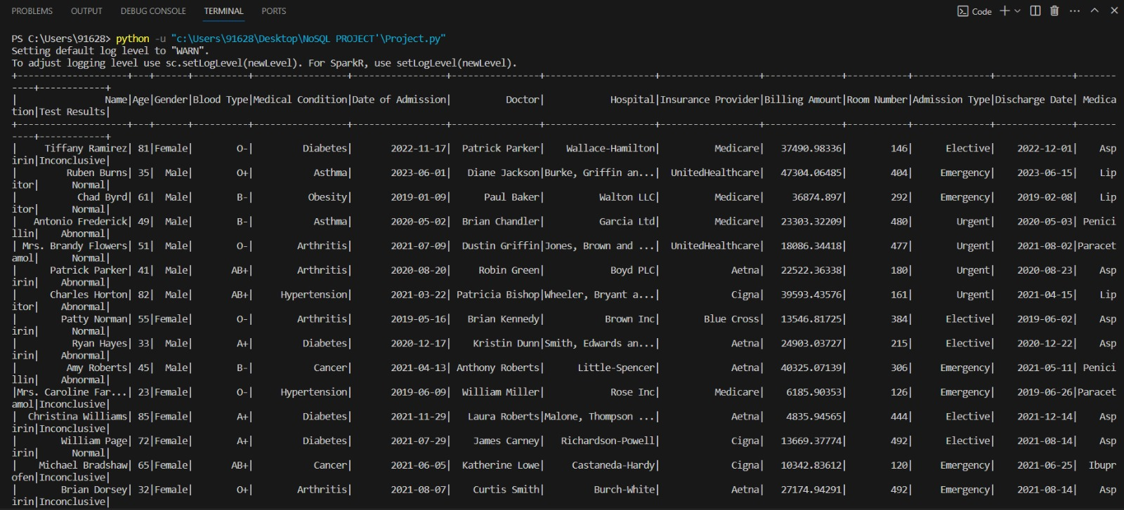
USING PYSPARK TO QUERY AND ANALYSE DATASET
IMPORT THE LIBRARY “SPARKSESSION”
CREATE A SPARKSESSION
LOAD THE DATASET INTO PYSPARK
SHOW THE DETAILS OF THE DATASET

Slide 35
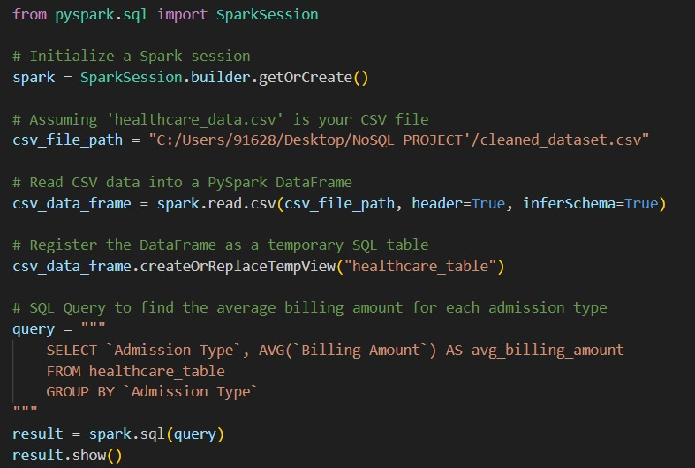
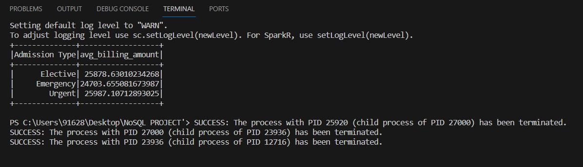
QUERY THE AVERAGE BILLING AMOUNT FOR EACH ADMISSION TYPE
INITIALIZE A “SPARKSESSION”
LOAD THE DATASET INTO PYSPARK
REGISTER THE DATAFRAME AS A TEMPORARY SQL TABLE
SHOW OUPUT OF QUERY

Slide 36
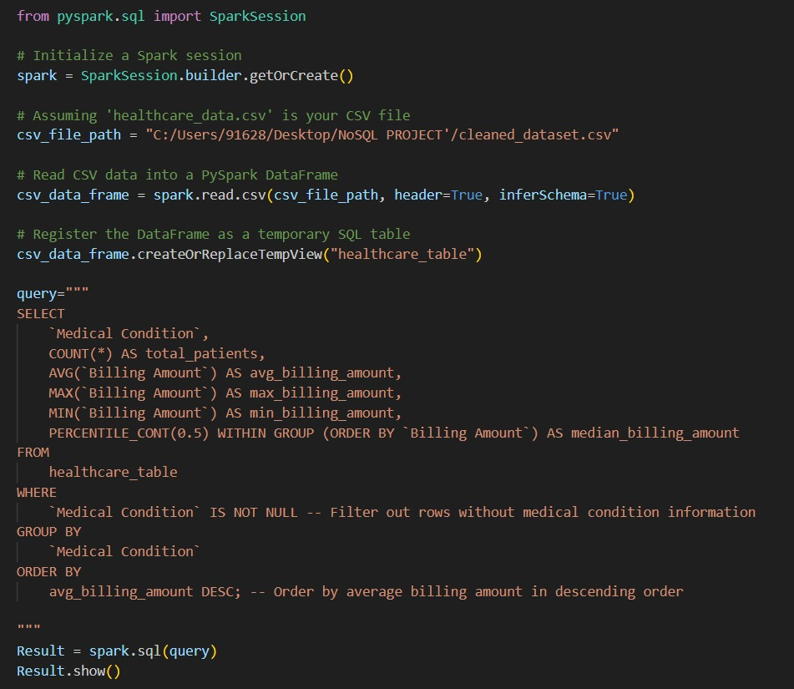
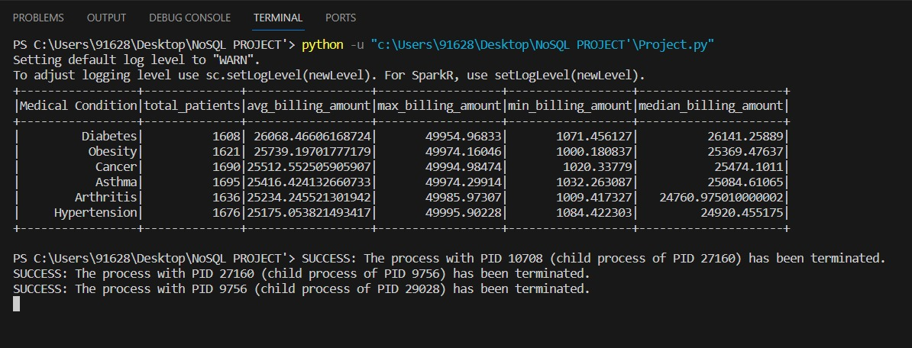
QUERY TO ANALYZE THE COST PAID BY PATIENTS FOR DIFFERENT AILMENTS
INITIALIZE A “SPARKSESSION”
LOAD THE DATASET INTO PYSPARK
REGISTER THE DATAFRAME AS A TEMPORARY SQL TABLE
SHOW OUPUT OF QUERY

Slide 37
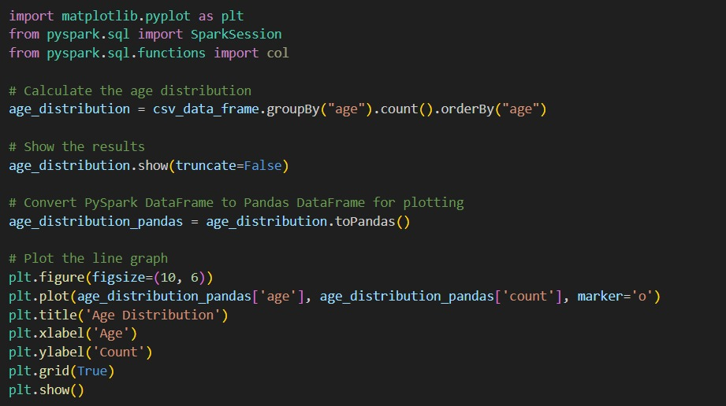
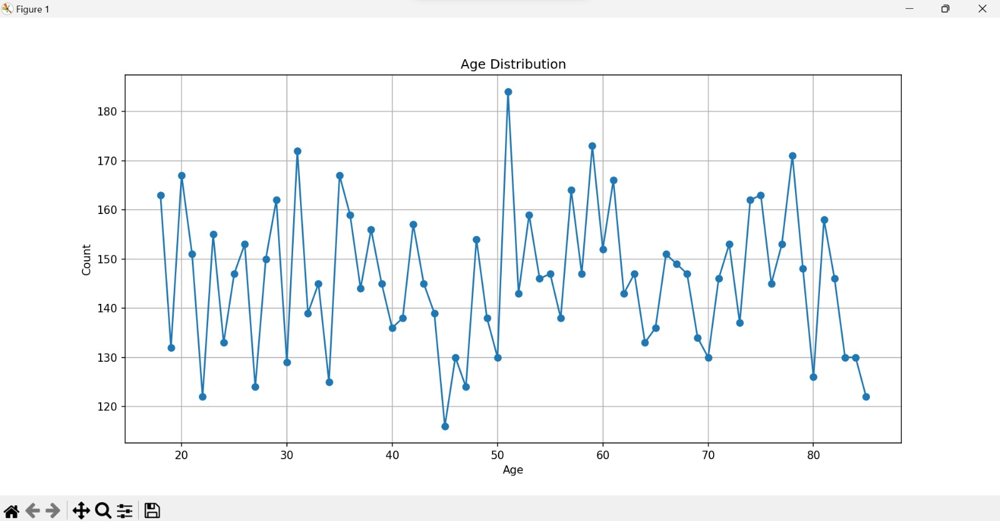
DATA VISUALIZATION USING PYSPARK
CALCULATE THE AGE DISTRIBUTION

Slide 38
DATA INSIGHTS FOR FUTURE
From predictive analysis, it can be seen that count of males and females is declining towards 2028. Also it is predicted that in next 5 year percent of male patients will be more as compared to female patients.

Slide 39
INSIGHTS ON HYPOTHESIS
After analysis we concluded that we have to reject our hypothesis discussed earlier as data shows that count of cancer patients has decreased over years as well as expenses had also declined.

Slide 40
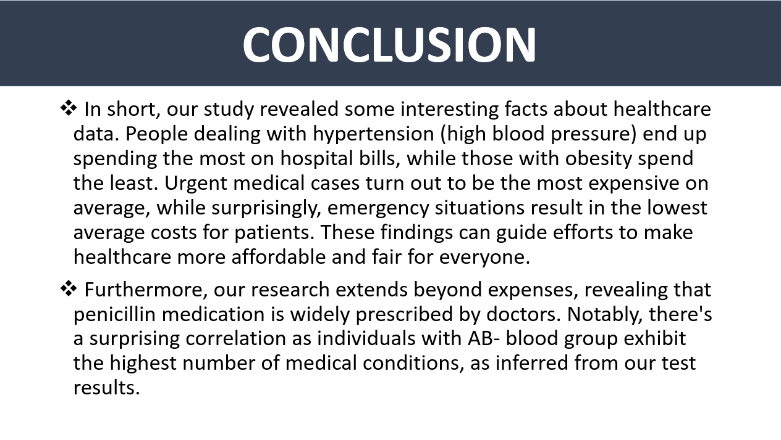

Slide 41

FOR LISTENING & FOR YOUR PATIENCE
FOR LISTENING AND YOUR PATIENCE

